Slide 1


Value-based decision making in attractor model, and its predictions of fMRI BOLD signals
CCN2021, Suzhou, China
Xinyuan Yan
7th Aug, 2021
xinyuanyan2016@gmail.com
https://twitter.com/XinyuanYan

Slide 2
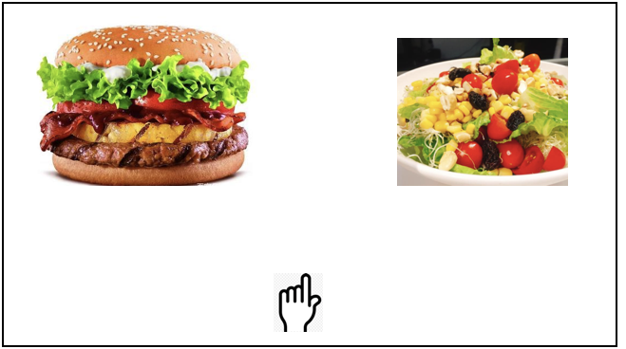
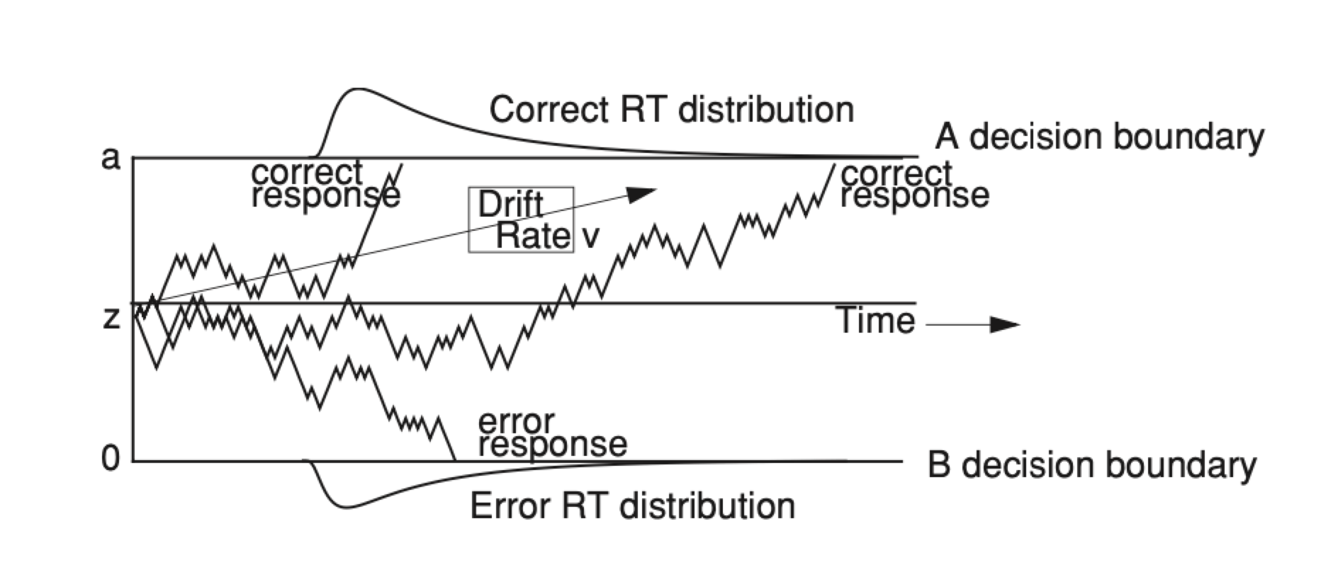
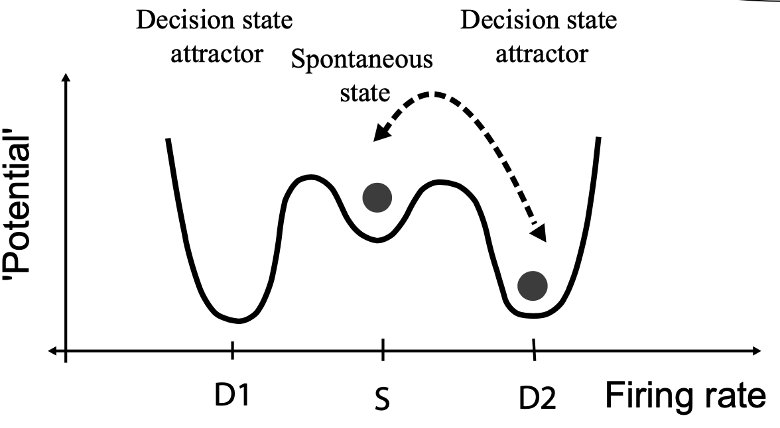
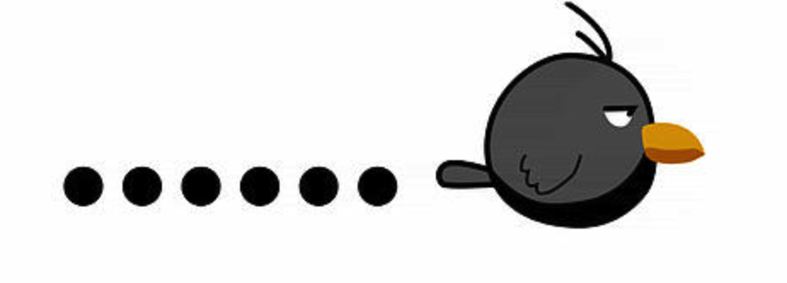

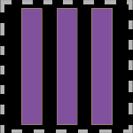
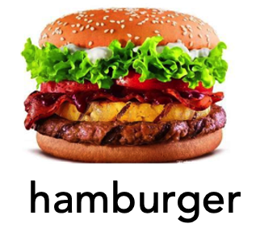
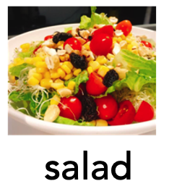
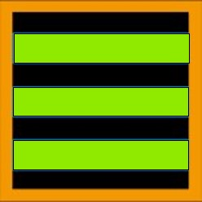


Background and Research question
Optimal decision making is crucial to survive and thrive!
Different models of decision-making (in simple explanation)
Value(calorie)-based decision making
Biophysically-realistic attractor model
with spiking neurons
Full drift diffusion decision model
hamburger
salad
…………………………………………..
Value(learning)-based decision making
First-passage time of a Wiener process
Reward!
Non-Reward
Figure adapted from
Ratcliff and McKoon, 2008
Neural computation
Figure adapted from Rolls et al., 2010
Journal of Neurophysiol
Q1: Will attractor network fit data better?

Slide 3
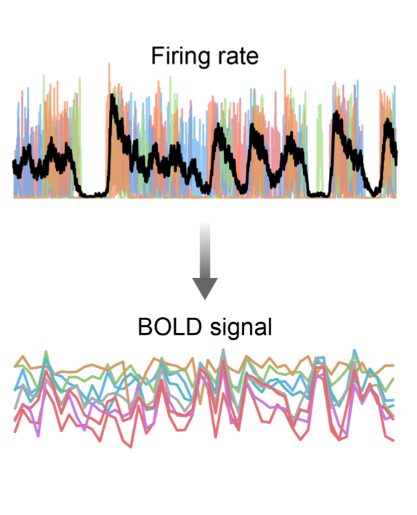
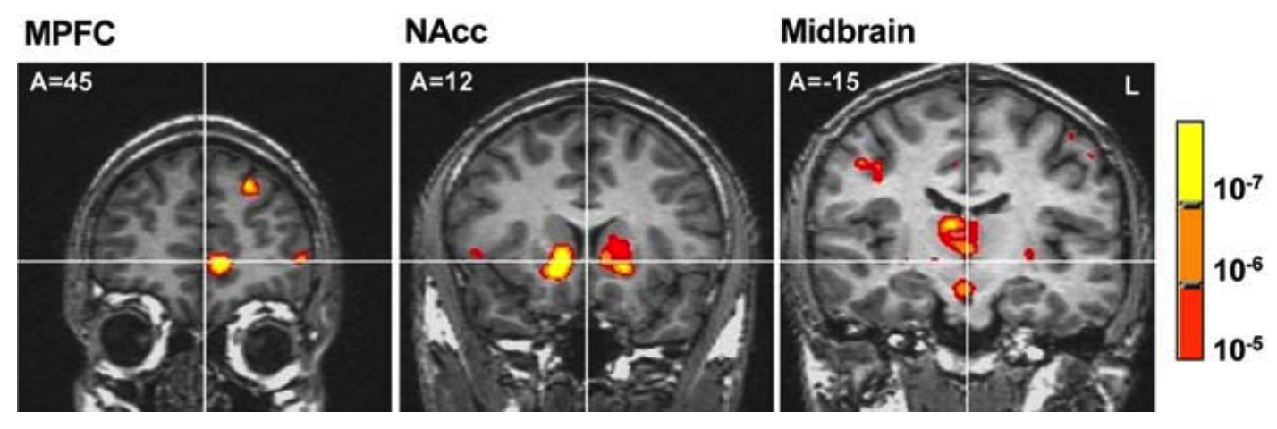
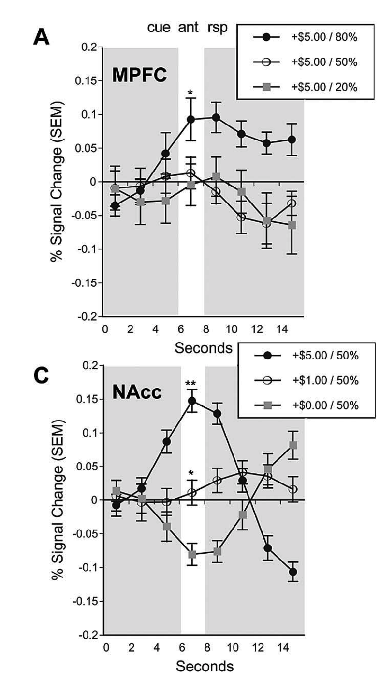
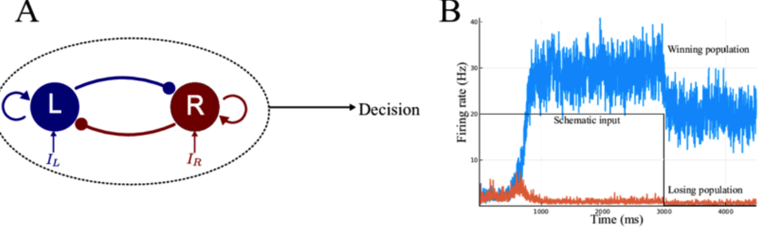
Background and Research question
The fMRI BOLD (blood oxygen level-dependent) signal may
reflect the total synaptic activity in an area
Figure adapted from Cakan et al., 2021, BioRxiv
Figure adapted from Wong and Wang et al., 2006, JN
Knutson et al., 2005, JN
Q2: Will the simulated fMRI BOLD signal show higher activation for higher value choices?

Slide 4
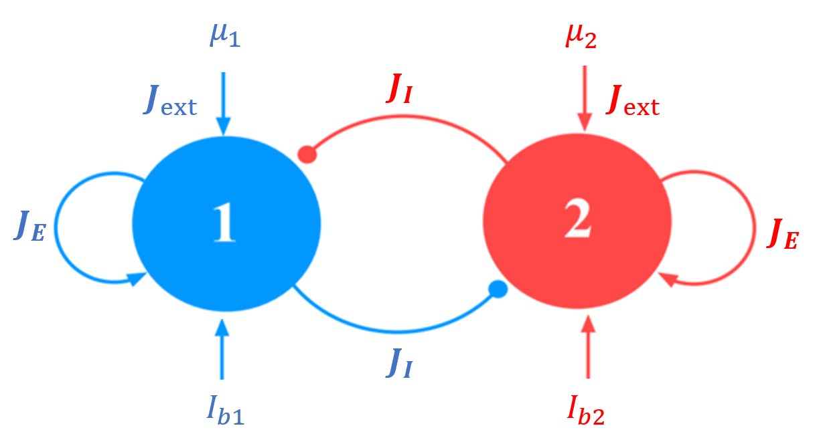
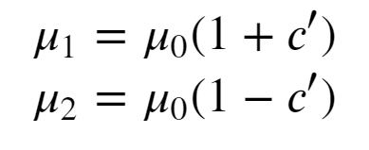
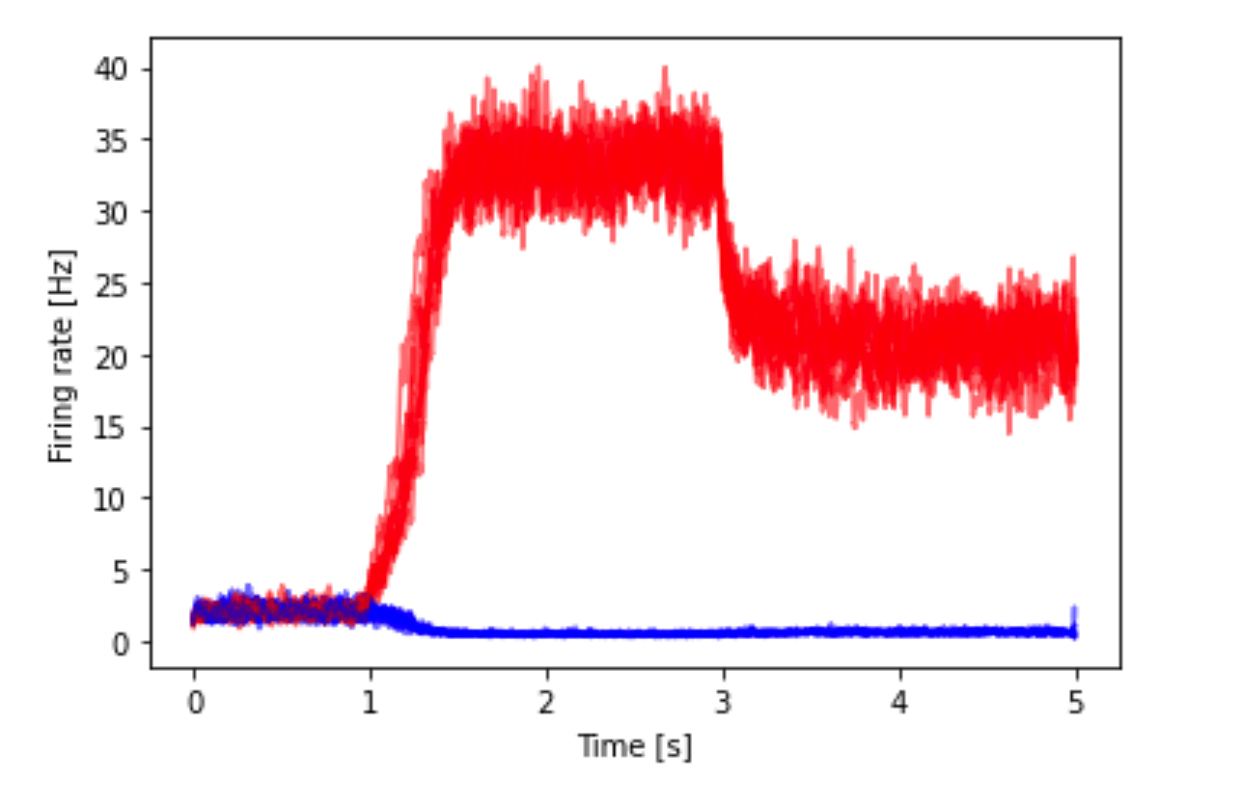
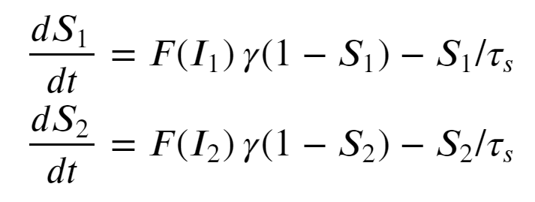
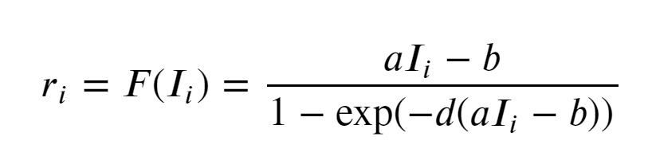
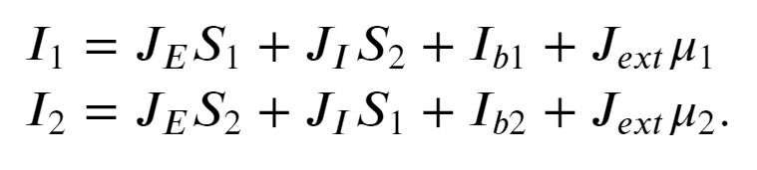
Method
Synaptic variables
Coherence-dependent inputs
Firing rates
Threshold
Input Current to each population
Figure and Equation were adopted from the CCN 2021 tutorial

Slide 5
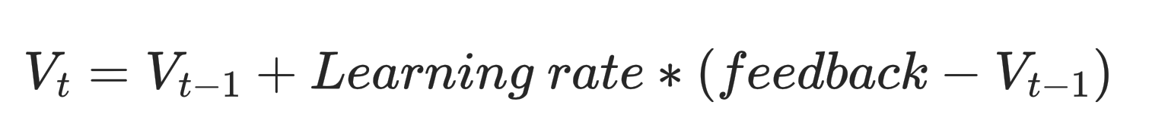
Method
In each trial
Free parameters:
Learning-rate
JE
JI
Threshold
Calculated the subjective value for choice1
and choice 2
Calculated the subjective value difference
(V1-V2)
Get the RT and choice in each trial
Minimize the point-wise difference
Between RT and modeled-RT
Setting the c’ = value difference
Coherence-dependent inputs

Slide 6
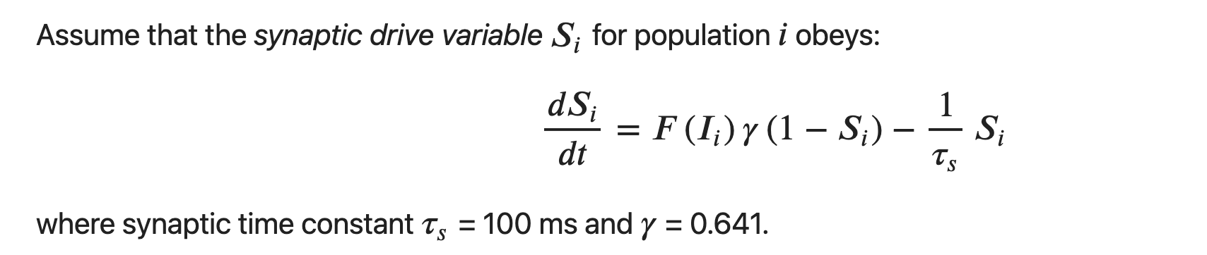
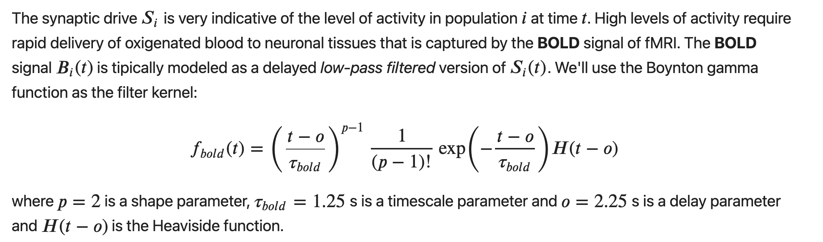
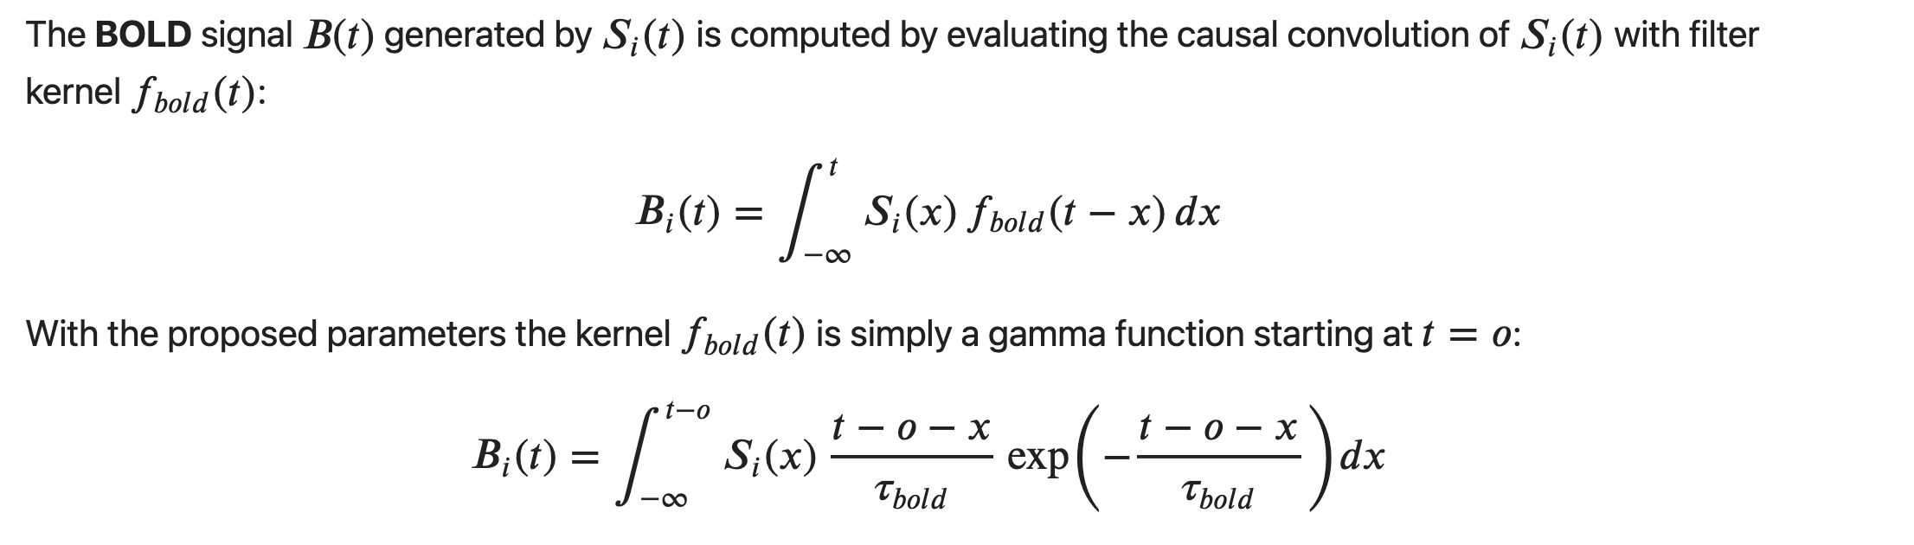
Method
Text and Equation were adopted from the CCN 2021 tutorial

Slide 7
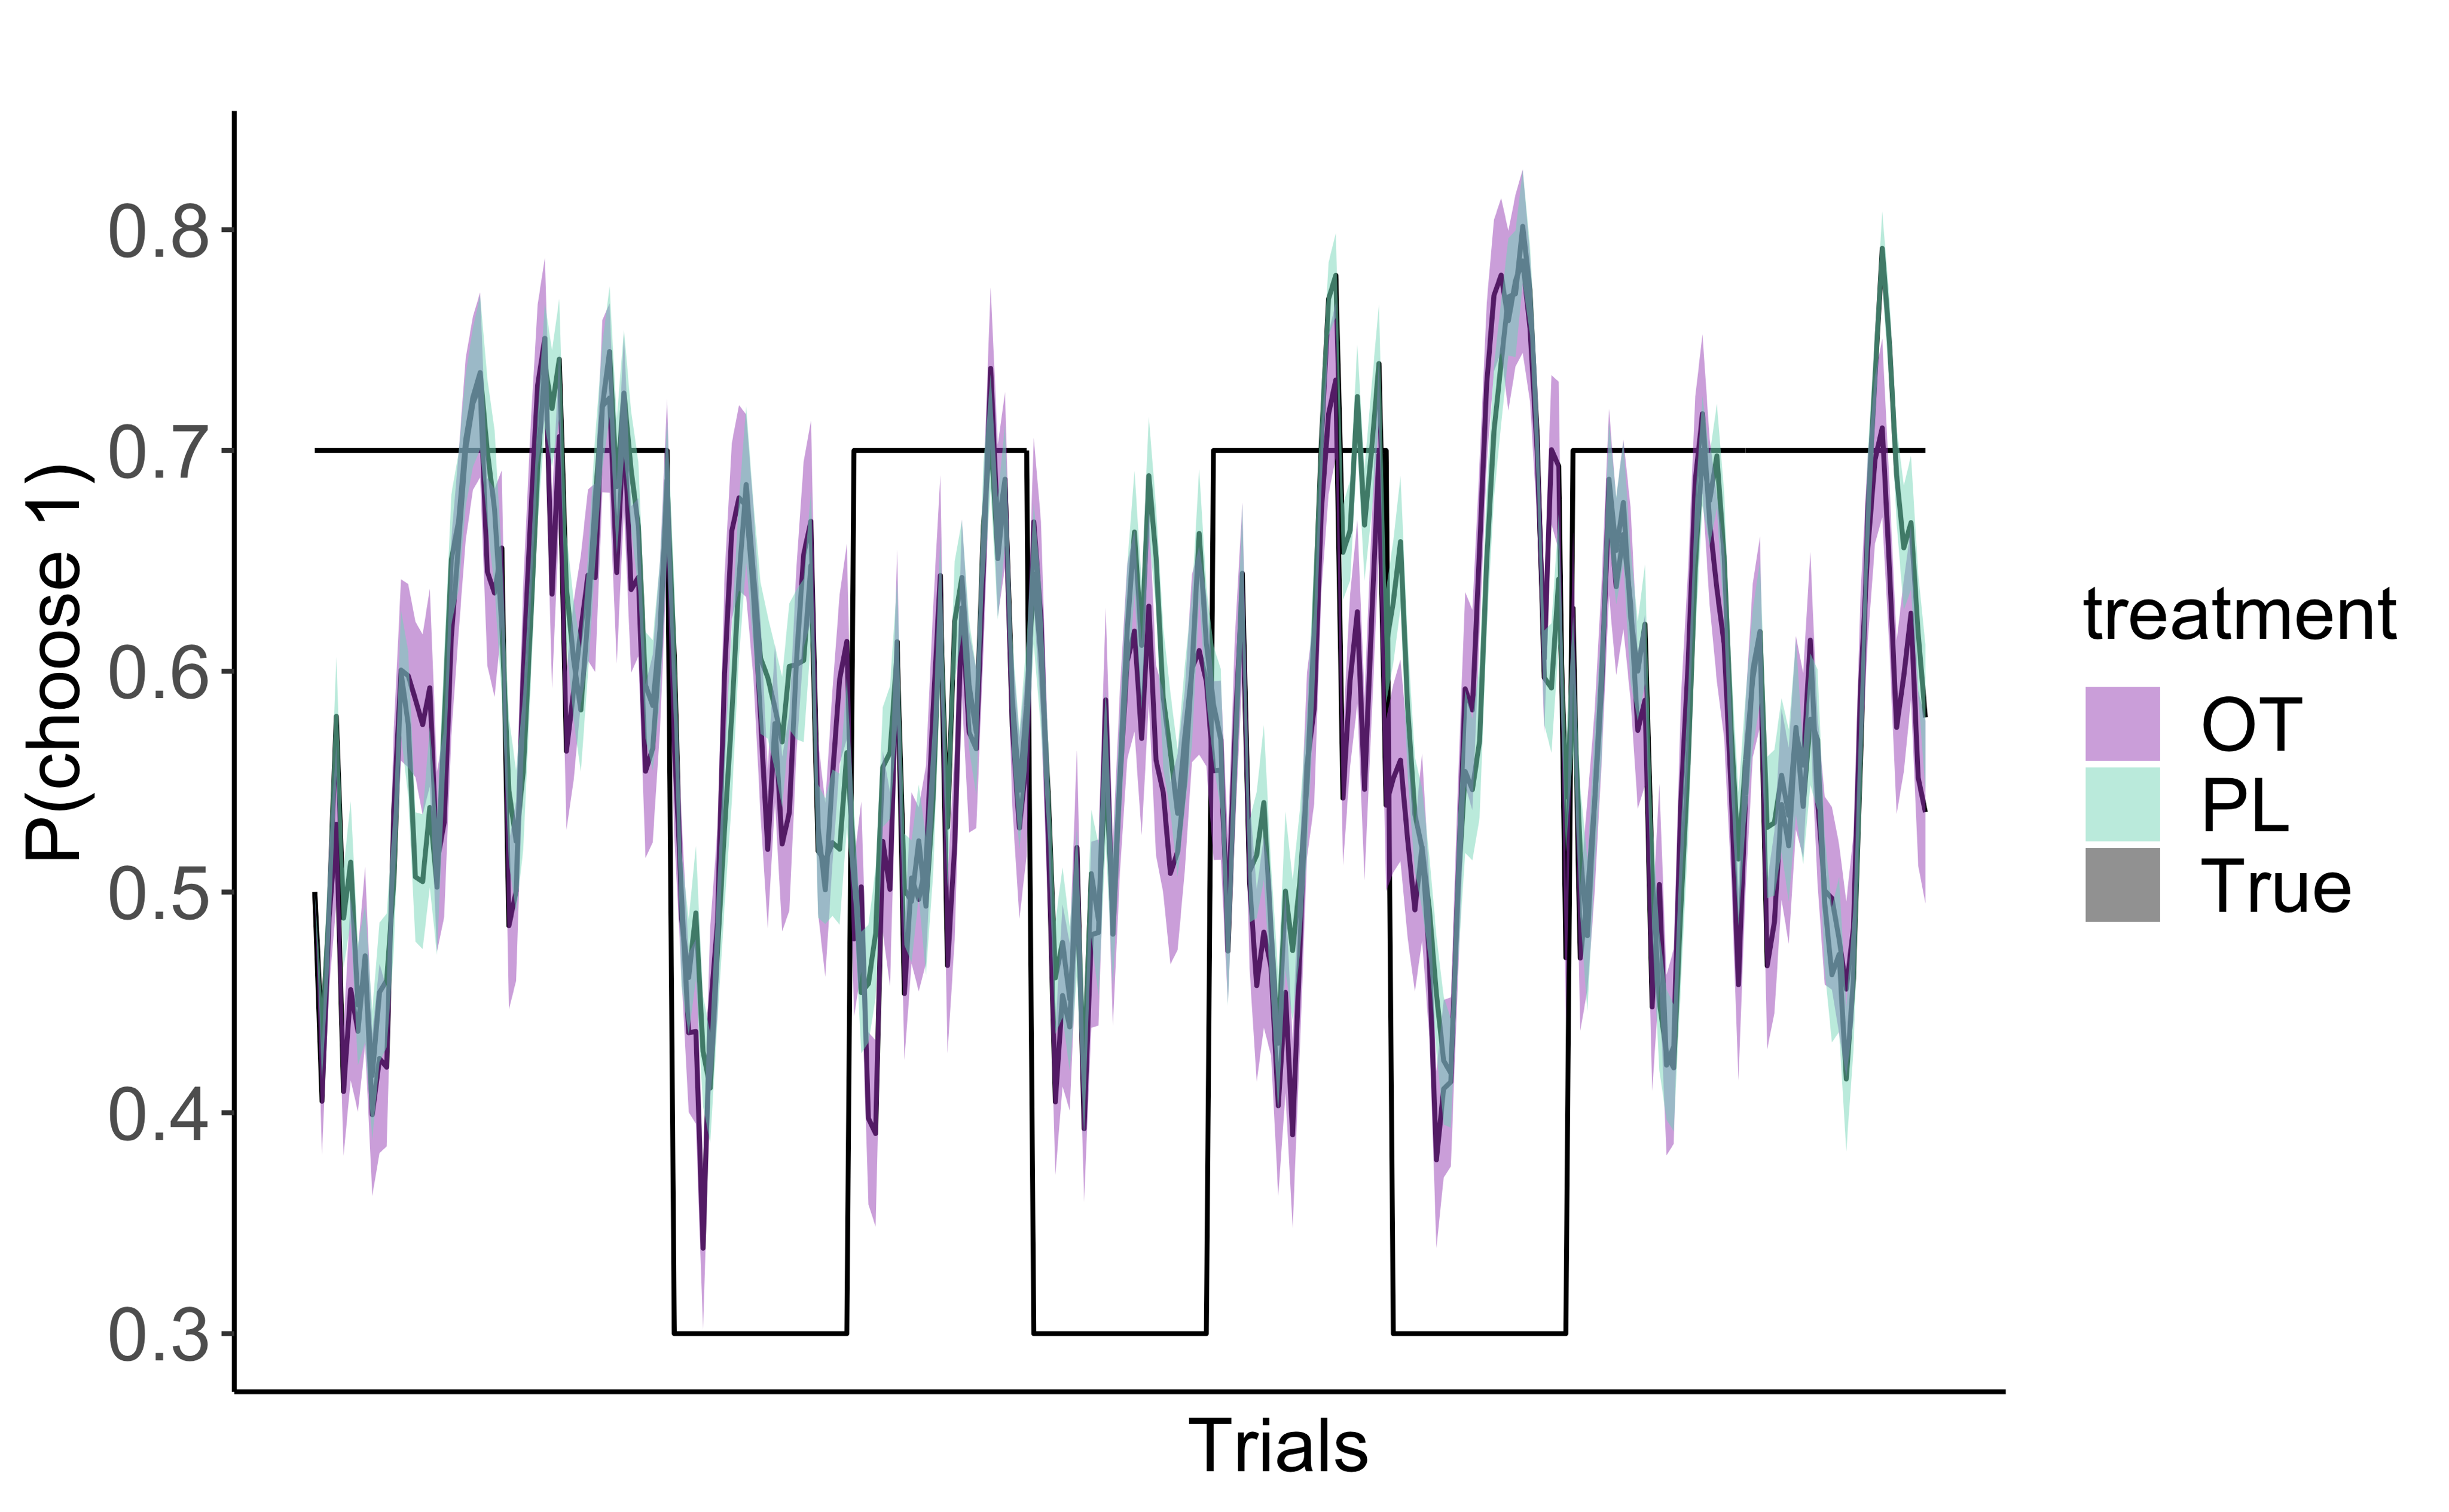
Method
Experimental task and Data
Reversal learning task with 225 trials
Try all the analysis mentioned above in 5 participants
All scripts were wrote in python (jupyter-notebook)
Goodbye! R & MATLAB!

Slide 8
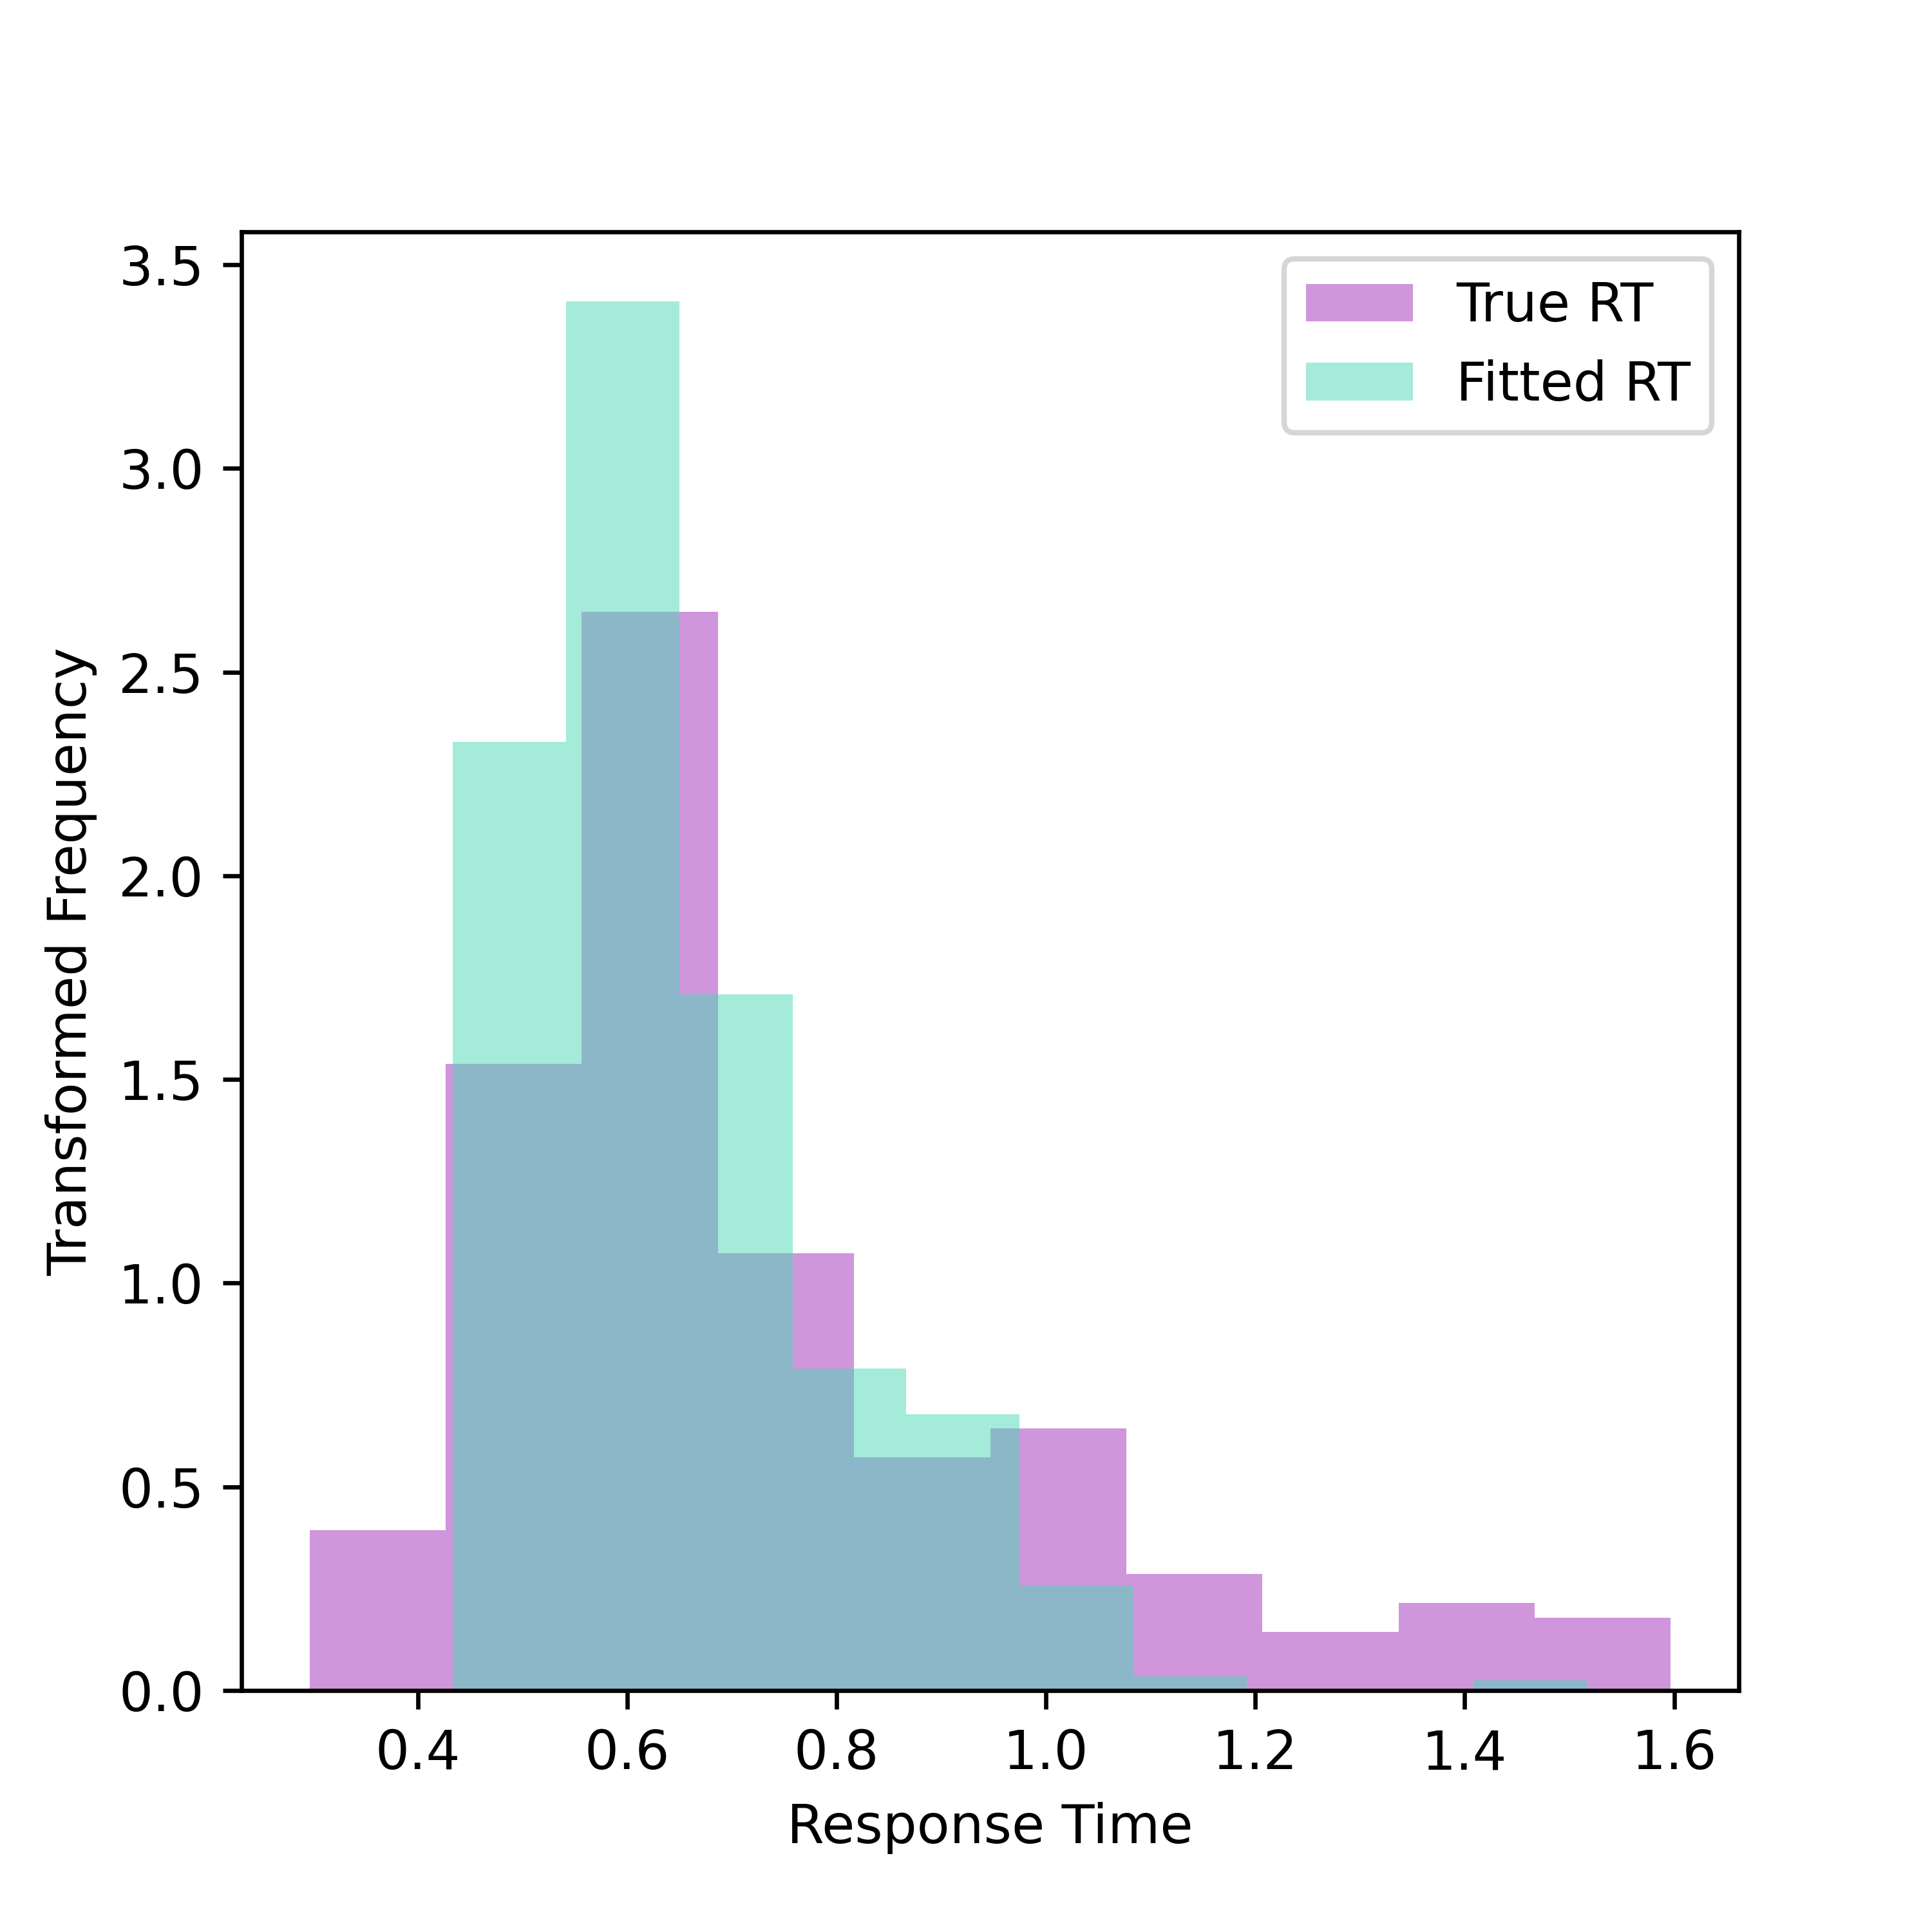
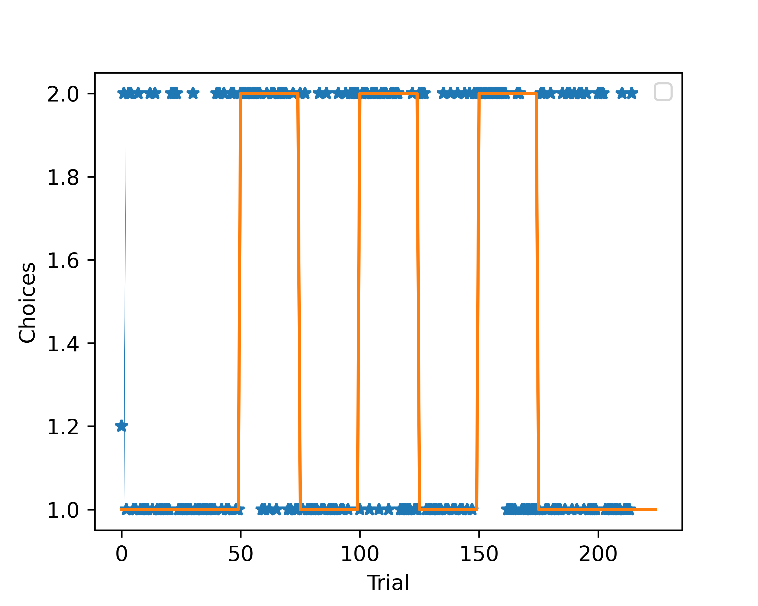
Results
Fitted response time and choices

Slide 9
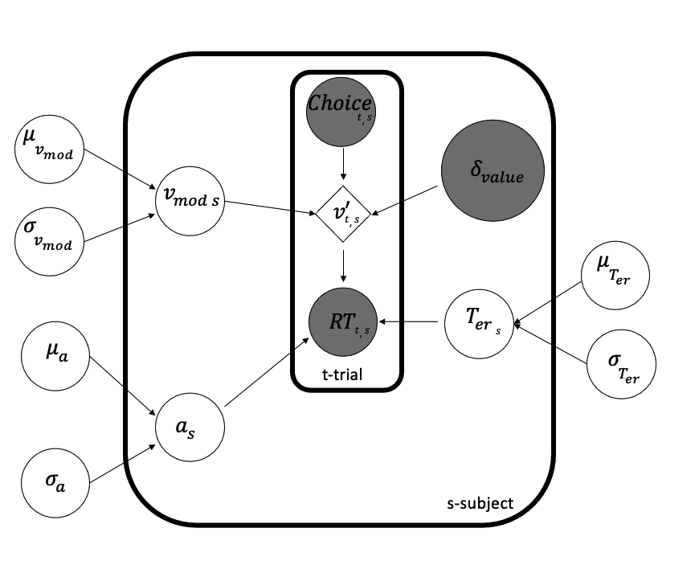
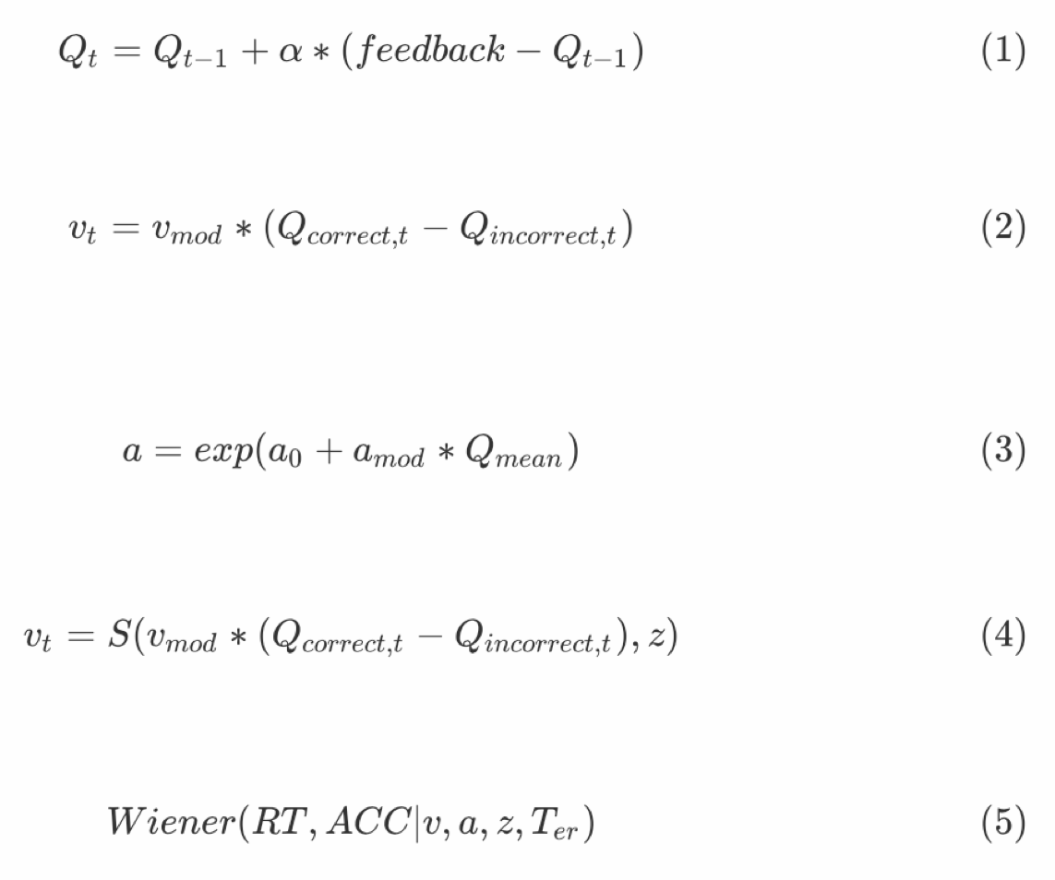
Results
Compared with previous DDM model
Rescorla-Wagner Diffusion decision model
Wining model (1 out of 12 alternative models)

Slide 10
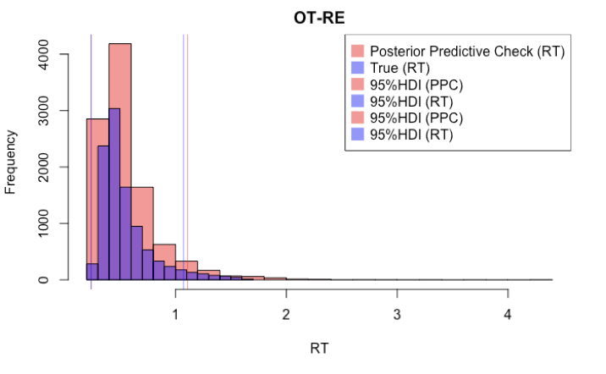
Results
Compared with previous DDM model
Rescorla-Wagner Diffusion decision model
Value-based attractor model

Slide 11
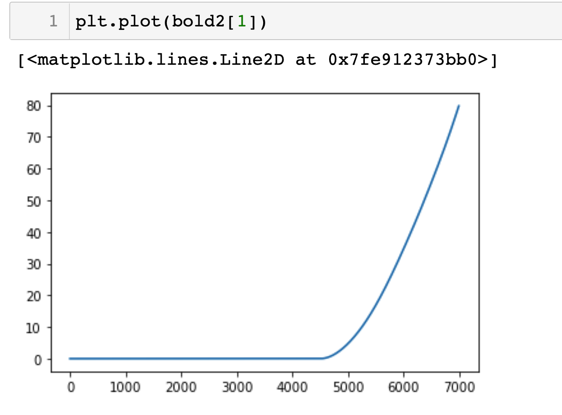
Results
Simulated fMRI BOLD signal
Failed…

Slide 12
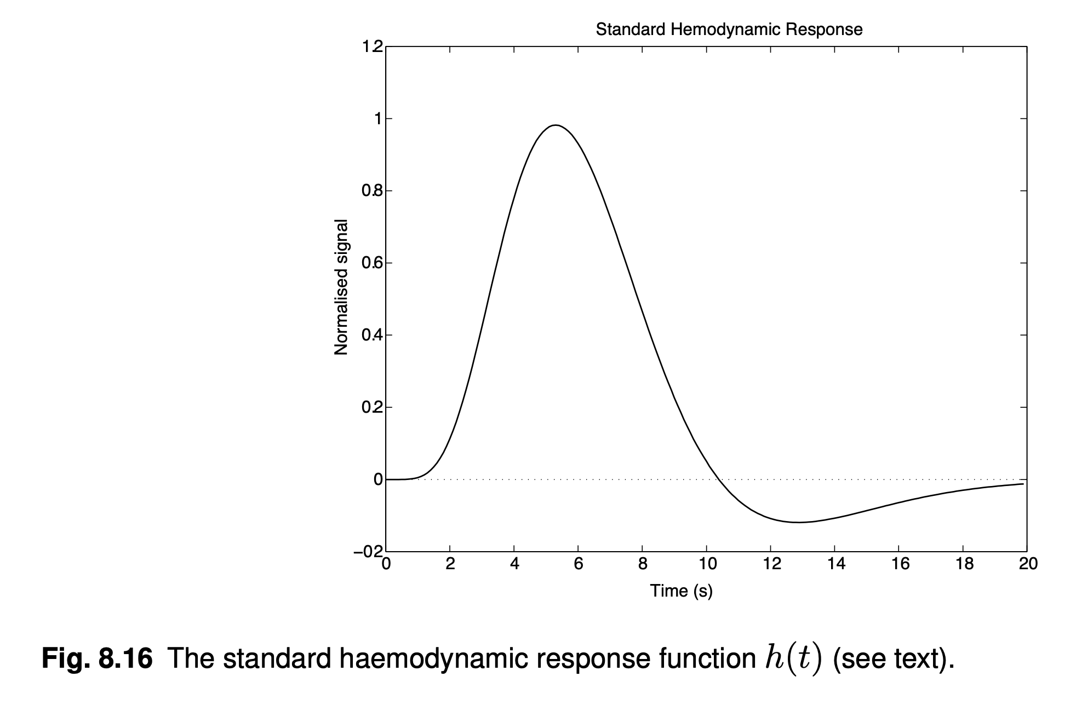
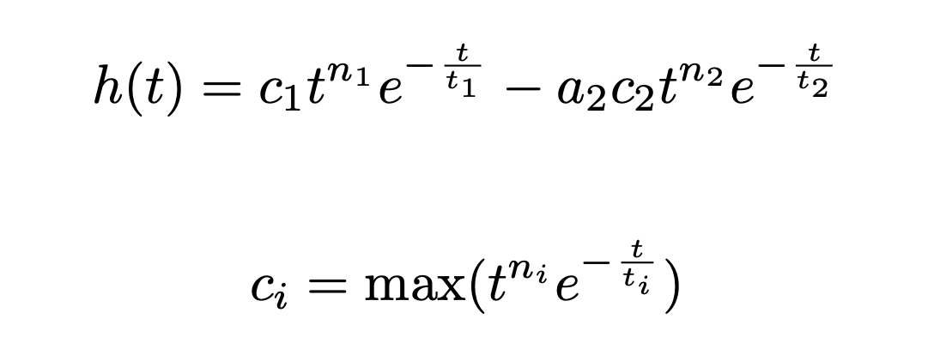
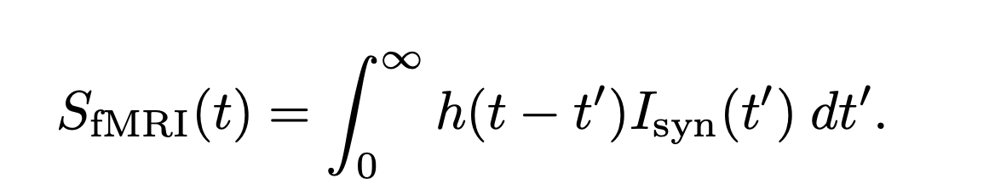
Revised Method and New Results
A good fit of the haemodynamical response h(t) can be achieved by the following analytic function:
The parameters utilized for the haemodynamic standard response (h(t)) were taken from Glover, 1999
n1 = 6.0
t1 = 0.9s
n2 = 12.0
t2 = 0.9s
a2 = 0.2
Glover, 1999
Rolls, 2013
Deco, Rolls & Horwitz, 2004

Slide 13
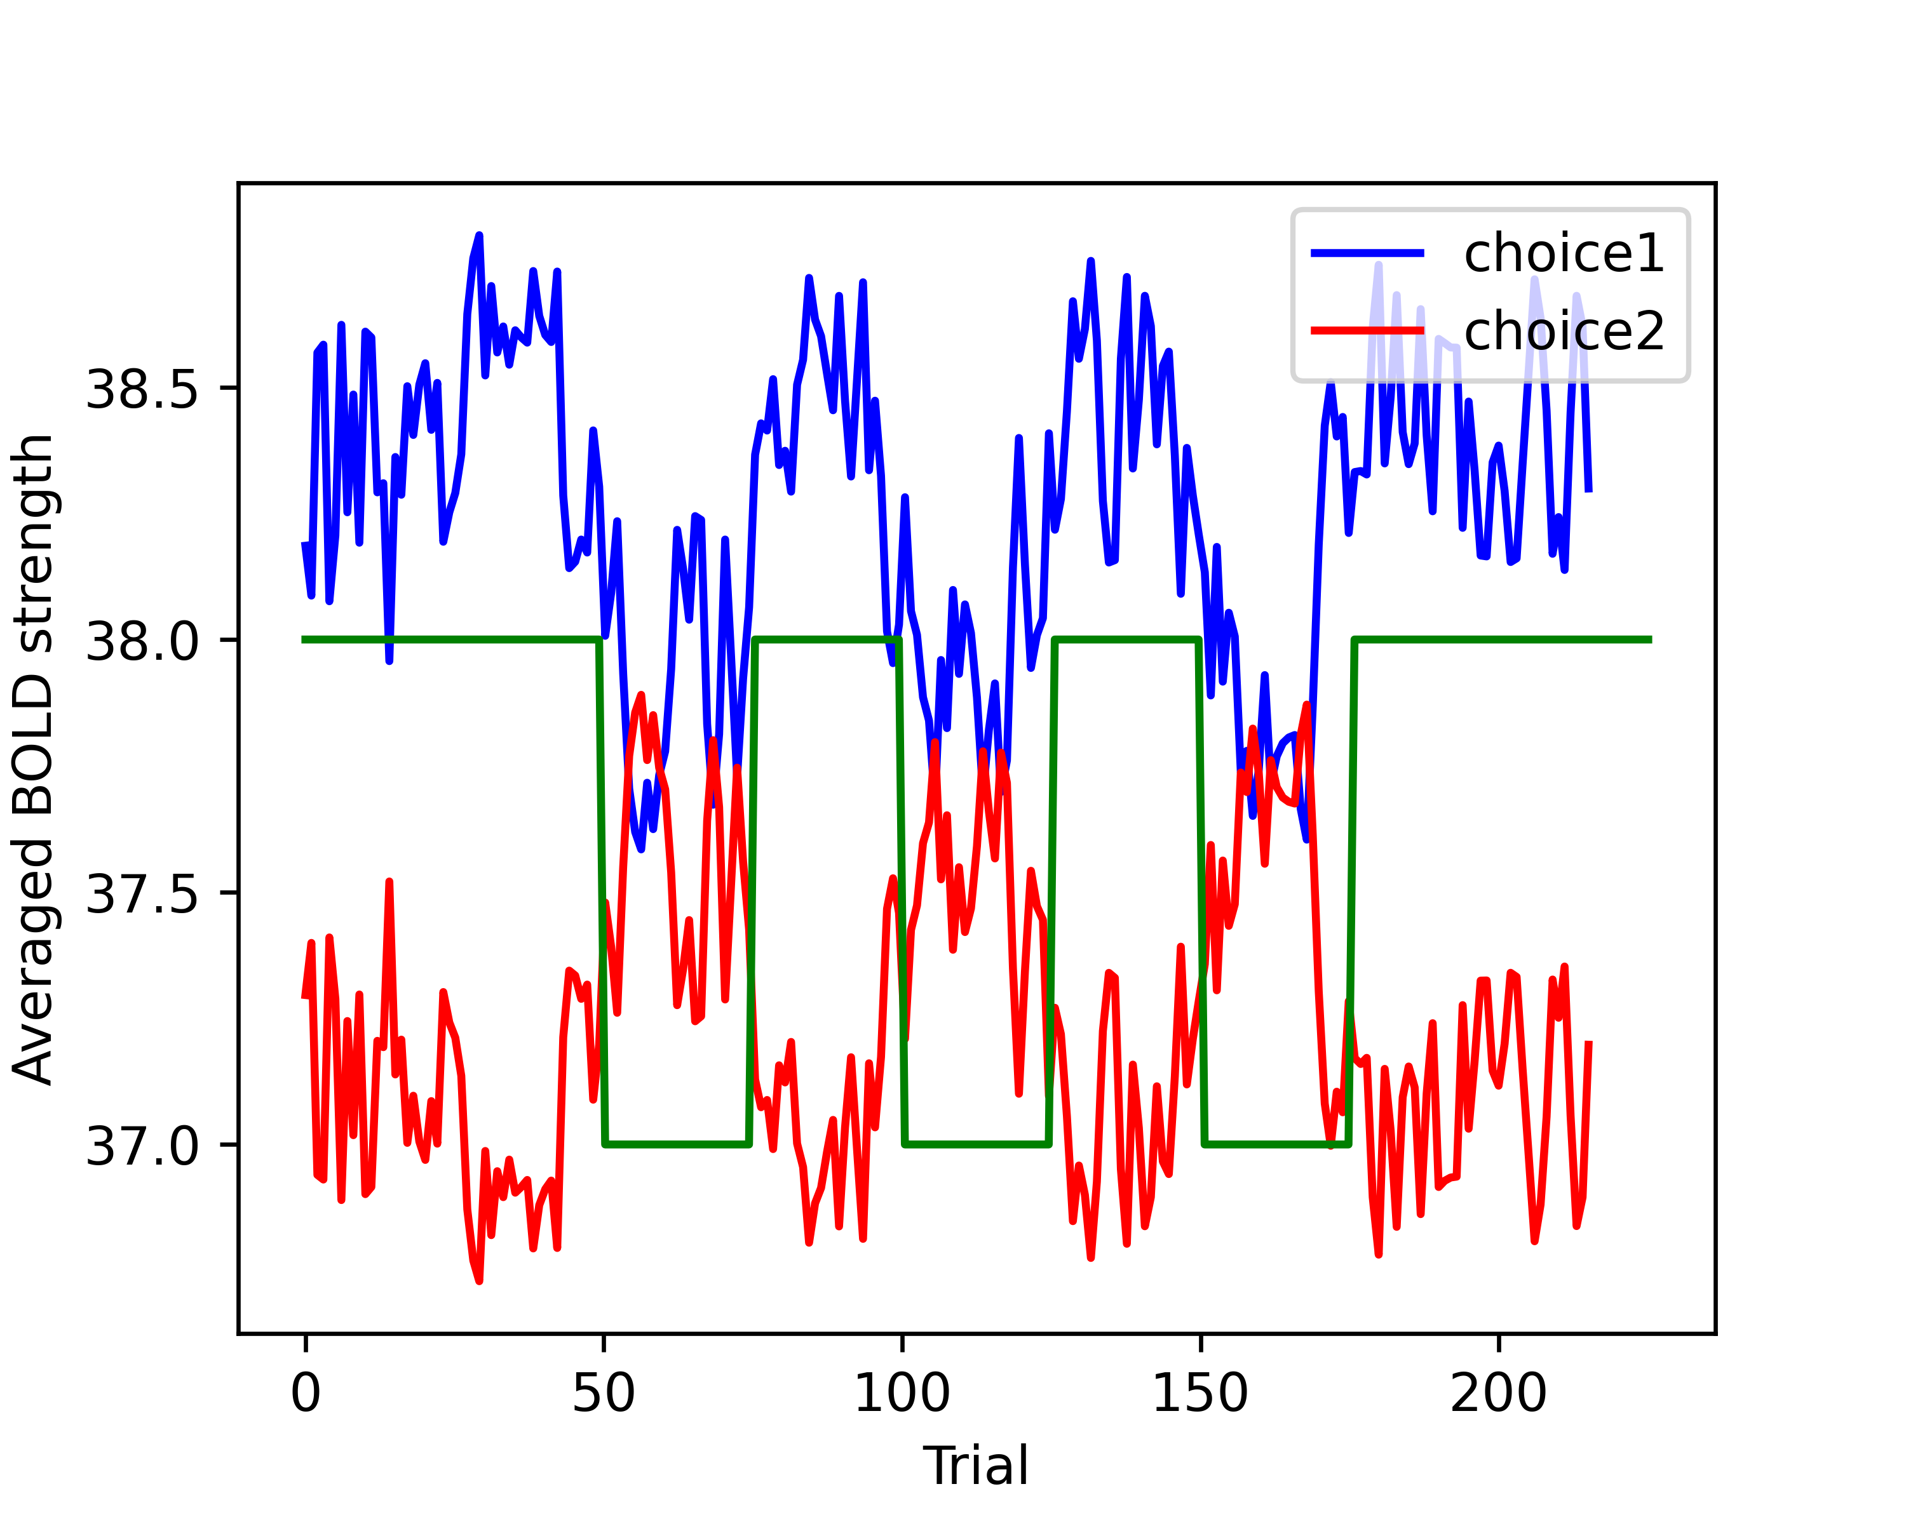
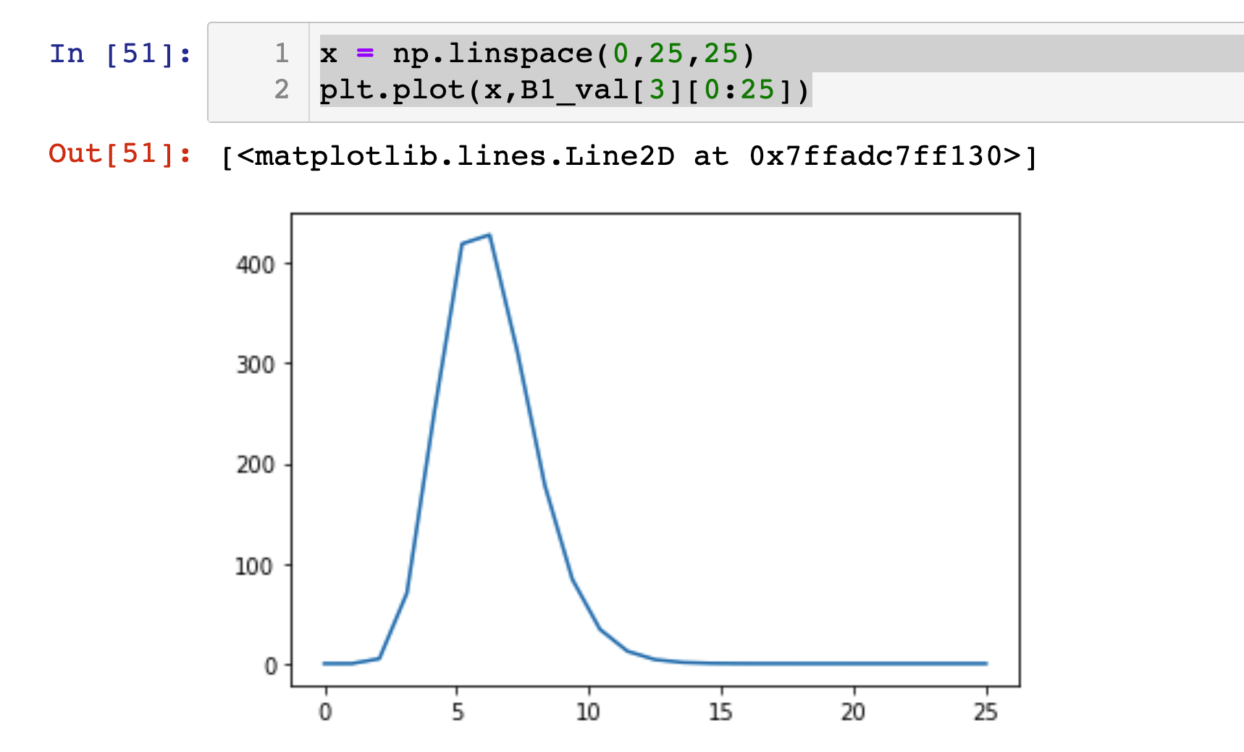
Revised Method and New Results
1>2
1>2
1>2
1>2
2>1
2>1
2>1

Slide 14
Revised Method and New Results
1>2
1>2
1>2
1>2
2>1
2>1
2>1

Slide 15
Limitations
Did not explore other free parameters, and how these potential parameters would affect the model performance.
Simulating fMRI BOLD signal only simply consider the value difference, but did not consider how these value difference would affect other parameters like JE or JI.

Slide 16
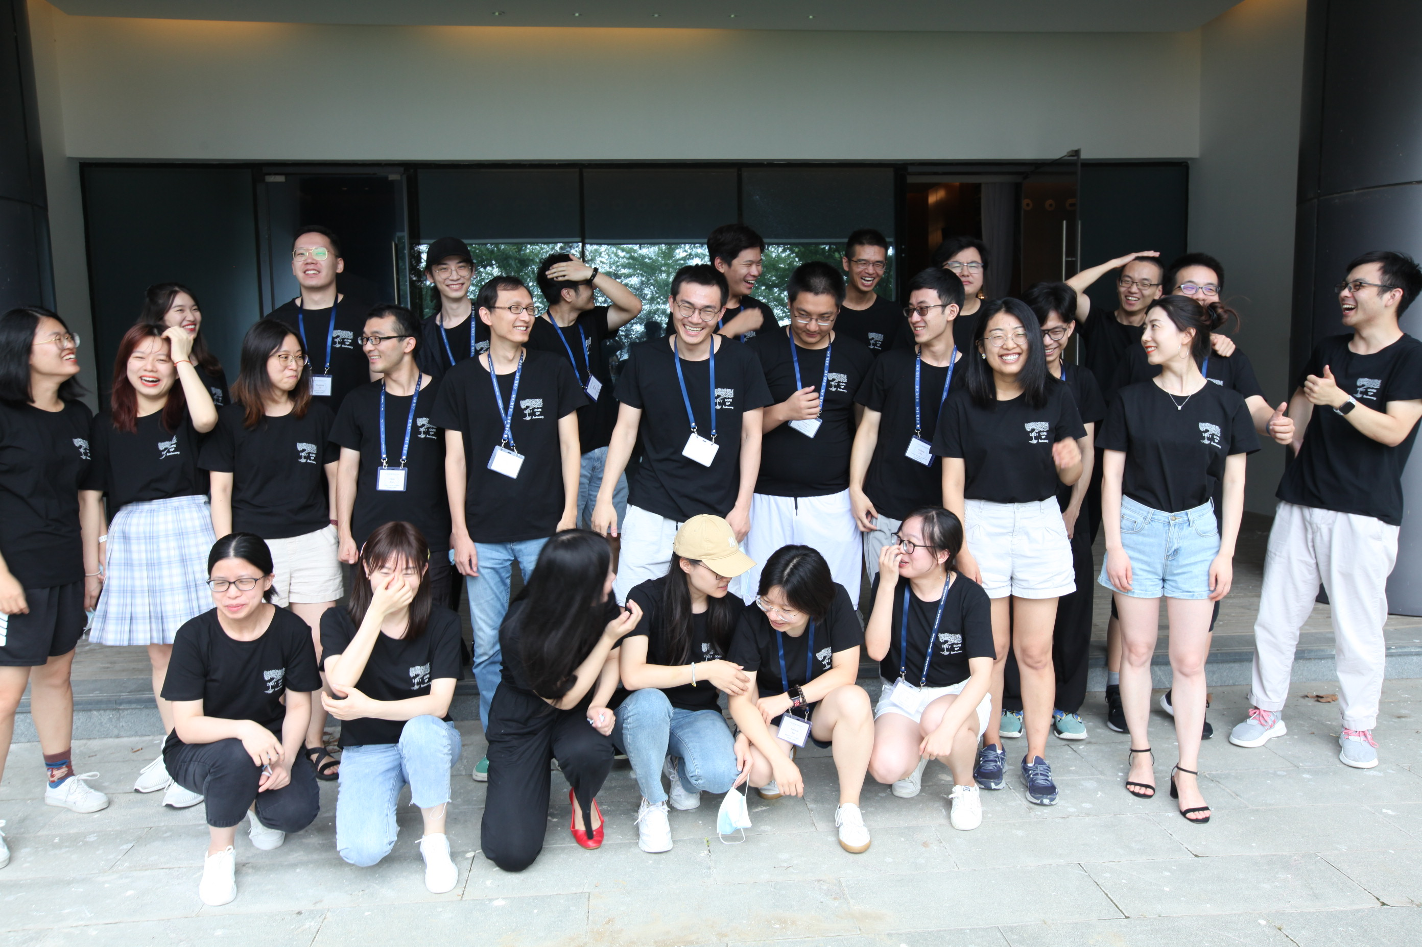

Acknowledgement
Amazing Faculties !!
Amazing TAs!!
Luis Garcia del Molino
Anqi Wu
Yuxiu Shao
Songting Li
Zilong Ji
All nice Classmates & CHSA assistants!
Chaoming Wang, Tianhao Chu, He Zhang, Bo Wang, Jingwen Chen, Hongxing Cao, Leijun Ye, Yaning Han, Xinyuan Yan, Ying Fan, Qianqian Shi, Bingyu Liu, Wenxuan Guo, Mengping Jiang, Ziling Wang, Zhaoning Li, Mengyang He, Shaonan Wang, Jinwen Wang, Zixiang Luo, Tengjun Liu, Yu Li, Lu Cao, Jian Li, Yuxin Pan, Huadong Xiong, Yu Xie, Meng Wang, Deying Song
Man Tou, Xinya Fan

